Slide 1


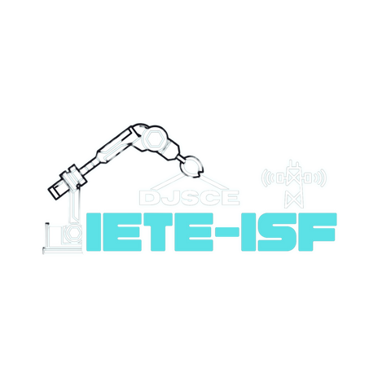







DEPARTMENT OF ELECTRONICS & TELECOMMUNICATION ENGINEERING
PRESENTS
2.0
A 24-HOUR HARDWARE HACKATHON
POWERED BY
ROUND 1 Submission

Slide 2
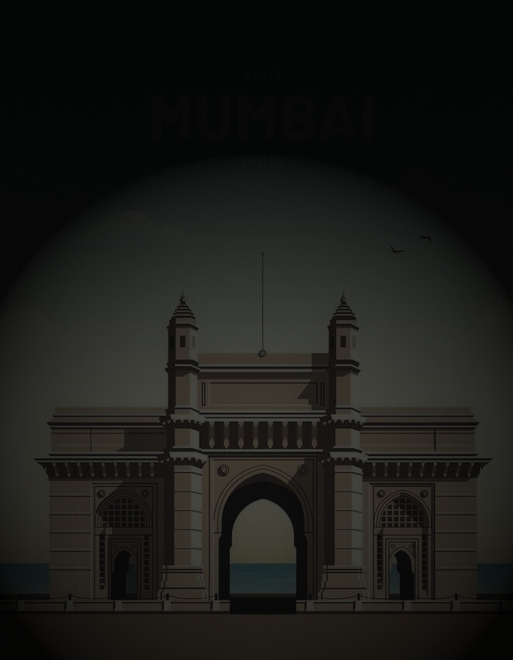
Introduction
2.0
A 24-HOUR HARDWARE HACKATHON
[Team Name]: CIRCUIT UNO
[Member Names]: KALASH BHEDA
VARAD BHANDARI
ARNAV BHANDARI
JASON DSOUZA
HEET BHARADWA AND MONIL JAIN
[College Name]:DJSCE

Slide 3
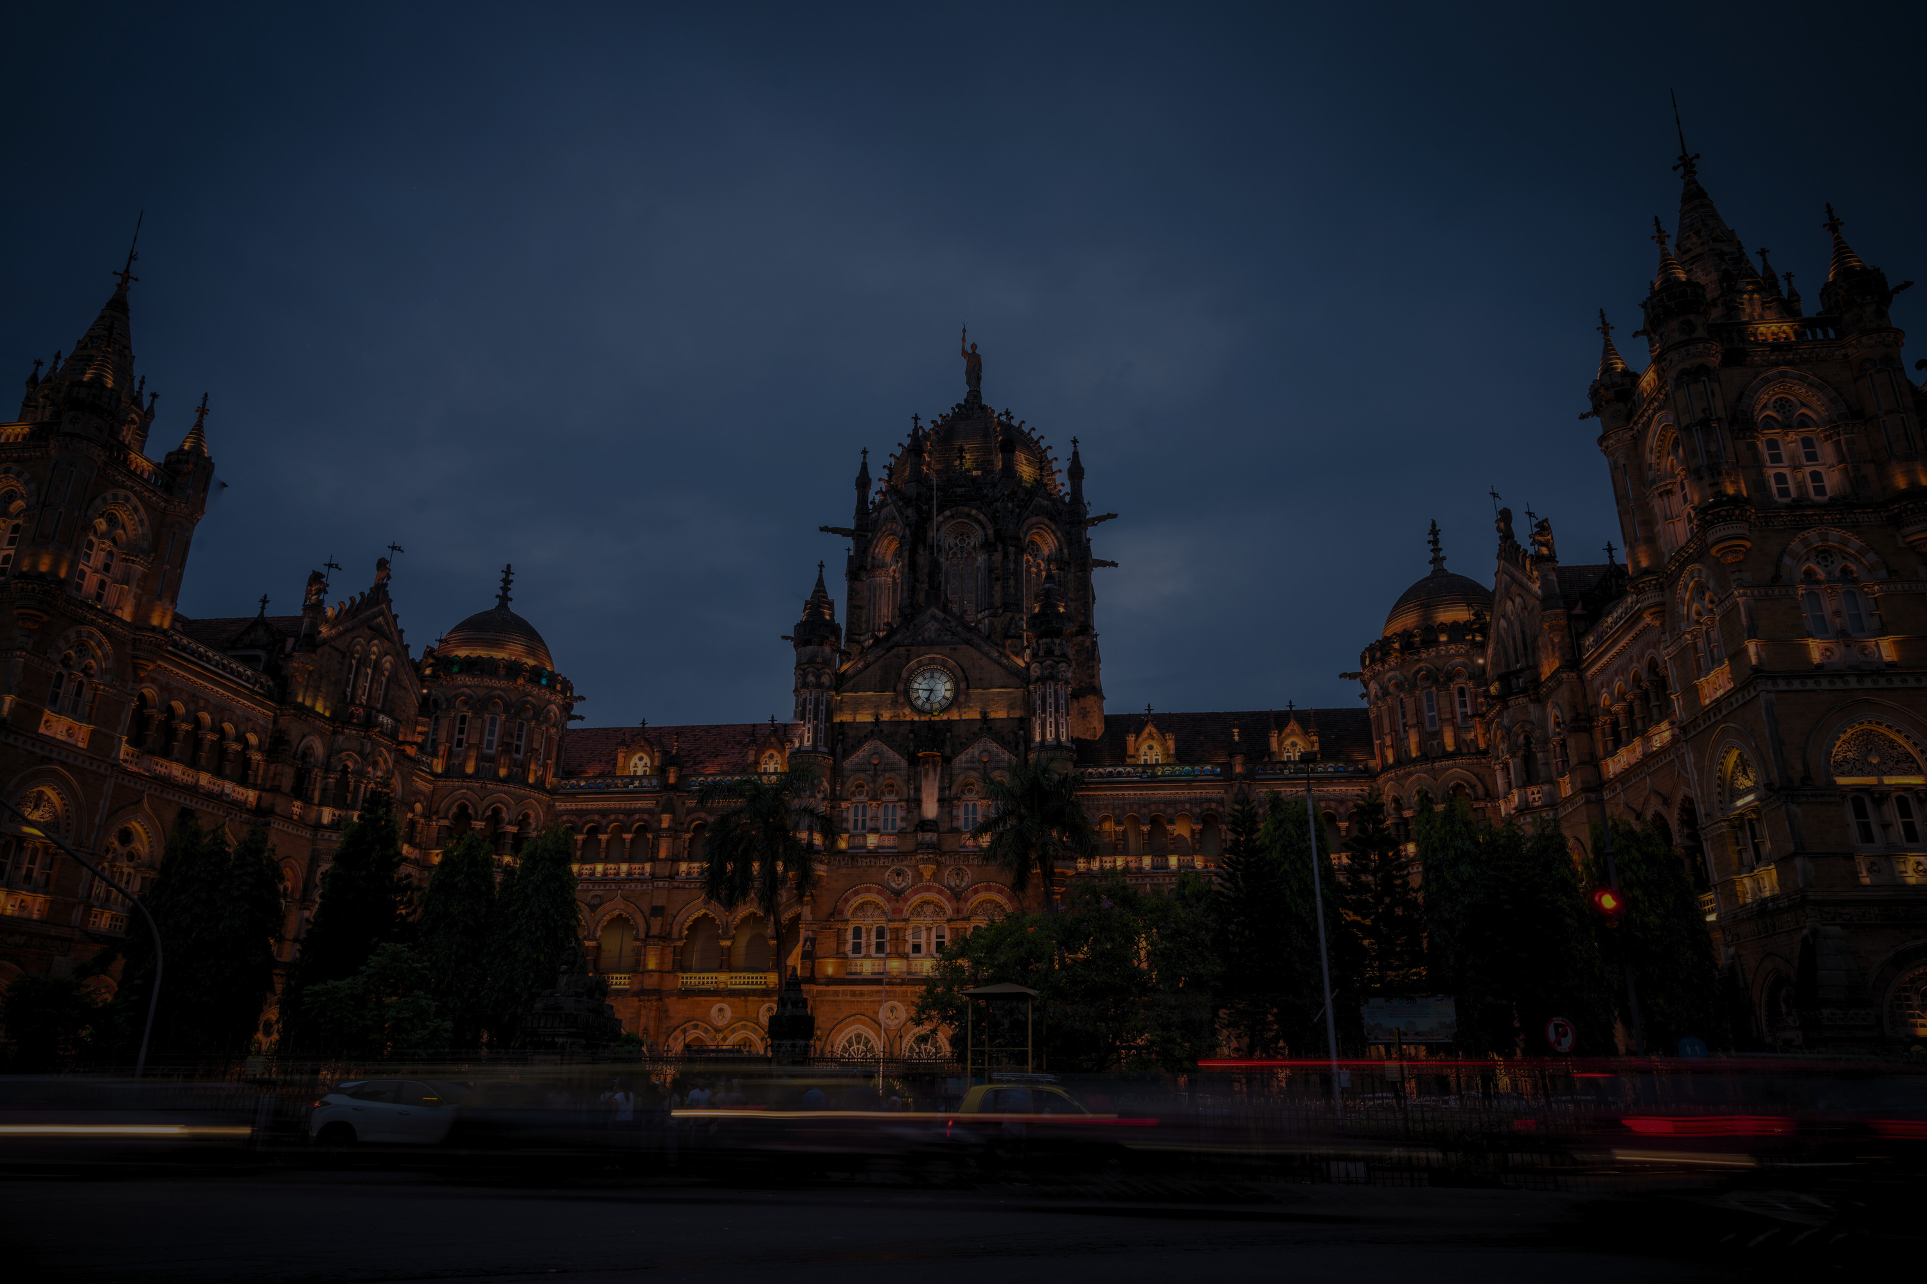
Problem Statement Overview
2.0
A 24-HOUR HARDWARE HACKATHON
[Comprehensive Overview of the problem statement]
The objective is to design an integrated IoT hardware solution to enhance urban traffic management, environmental monitoring, and public safety within a smart city framework. Rapid urbanization presents challenges in resource management and infrastructure efficiency, which can be tackled using IoT and GIS technologies for real-time data collection, spatial analysis, and informed decision-making. These systems will optimize traffic flow, monitor environmental conditions, and enhance public safety, leading to smarter, safer, and more sustainable cities. The initiative fosters innovative, practical solutions that improve quality of life and ensure a brighter, more efficient urban future.
[Team Name]:

Slide 4
Highlighted Problems
2.0
A 24-HOUR HARDWARE HACKATHON
[Key Issues: Identified problems from the Problem statement and effect on public]
Enviournmental and public safety: The problem is inefficient waste management and poor hygiene in public spaces due to open dustbins, leading to odors, pests, and littering. Overflowing bins and lack of real-time monitoring result in delayed or unnecessary waste collection. Our solution automates waste disposal, ensures hygiene, and optimizes collection efficiency in smart cities.
Traffic management: The problem we are tackling is traffic congestion during peak hours and delays for emergency vehicles. Traditional traffic signals often create bottlenecks, leading to longer travel times and increased pollution. During emergencies, ambulances face difficulty navigating through heavy traffic, which can delay response times and jeopardize lives. Our solution aims to optimize traffic flow by adjusting signal timings in real time to reduce congestion and prioritize emergency vehicles, ensuring smoother travel for both regular commuters and ambulances.
[Team Name]:

Slide 5
The Solution Blueprint
2.0
A 24-HOUR HARDWARE HACKATHON
[Detailed explanation of the proposed solution]
1
Our project is a smart dustbin designed to improve waste management in public spaces by addressing issues of hygiene, odor, and inefficiency. Traditional dustbins often remain open, leading to unpleasant smells, pest infestations, and improper waste disposal. Our smart dustbin uses ultrasonic sensors to detect when a hand is approaching, triggering the opening of the lid. The lid automatically closes once the hand moves away, keeping the dustbin sealed and preventing odors and flies.
To further enhance user interaction and provide useful information, we’ve incorporated an LCD display that shows the waste level, environmental tips, and other relevant data. Additionally, the dustbin is equipped with a system that sends real-time notifications to the local garbage authority when the bin is full, ensuring timely waste collection and preventing overflow.
This automated solution optimizes waste disposal, promotes cleanliness, and reduces the manual effort involved in waste collection, making public spaces cleaner and more hygienic
2
Our project is a smart traffic light system designed to reduce congestion during peak hours and prioritize emergency vehicles. Traditional traffic lights often cause bottlenecks, especially during rush hours, leading to longer travel times and increased pollution. Emergency vehicles like ambulances face delays in heavy traffic, compromising response times.
This system uses an Arduino , GIS systems and ESP32 to control traffic light timings dynamically, based on real-time traffic data. Emergency vehicles are equipped with buttons that, when pressed, send a signal to the traffic light system. This signal prompts the system to alter the traffic light sequence and create a clear path for the emergency vehicle, ensuring faster response times.
An LCD screen displays important information, such as the current signal status and any emergency vehicle requests. LEDs clearly indicate the status of each signal. The system optimizes traffic flow, reduces congestion, and ensures timely passage for emergency vehicles, enhancing both daily commutes and emergency services.
The uniqueness of our projects lies in their integration of real-time data and automation to solve common public service problems. The Smart Dustbin System stands out with its ultrasonic sensors that detect hand movements, automatically opening and closing the lid, preventing odors and pests, while sending real-time notifications for timely waste collection. The Smart Traffic Light System is unique for dynamically adjusting signal timings based on traffic flow and prioritizing emergency vehicles, ensuring faster response times and reducing congestion. Both projects offer smart, automated solutions that enhance hygiene, traffic efficiency, and overall public service.
[Innovation and uniqueness of the proposed solution]
[Team Name]:

Slide 6
Technical Approach
2.0
A 24-HOUR HARDWARE HACKATHON
[Technologies Used: List programming languages, frameworks, tools, and include GIS integration.]
Arduino ide, python Arduino,esp32,led lights,lcd screen , servor motor, ultrasonic sensor , push buttons
[Team Name]:

Slide 7
Technical Approach
2.0
A 24-HOUR HARDWARE HACKATHON
GIS Integration:
1. Real-Time Traffic Monitoring – Tracks congestion using sensors and GPS.
2. Smart Traffic Signal– Adjusts signal timings based on vehicle density.
3. Emergency Route Optimization– Finds the fastest routes for ambulances, fire trucks, and police.
4. Accident Detection & Response – Identifies crashes and alerts emergency services.
[Team Name]:

Slide 8
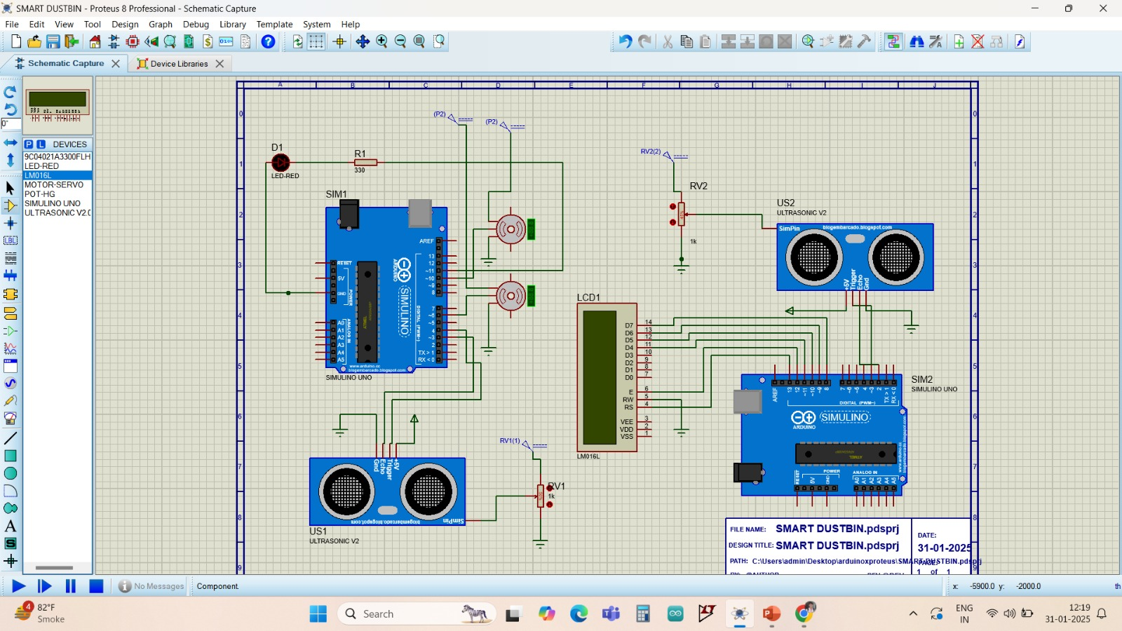
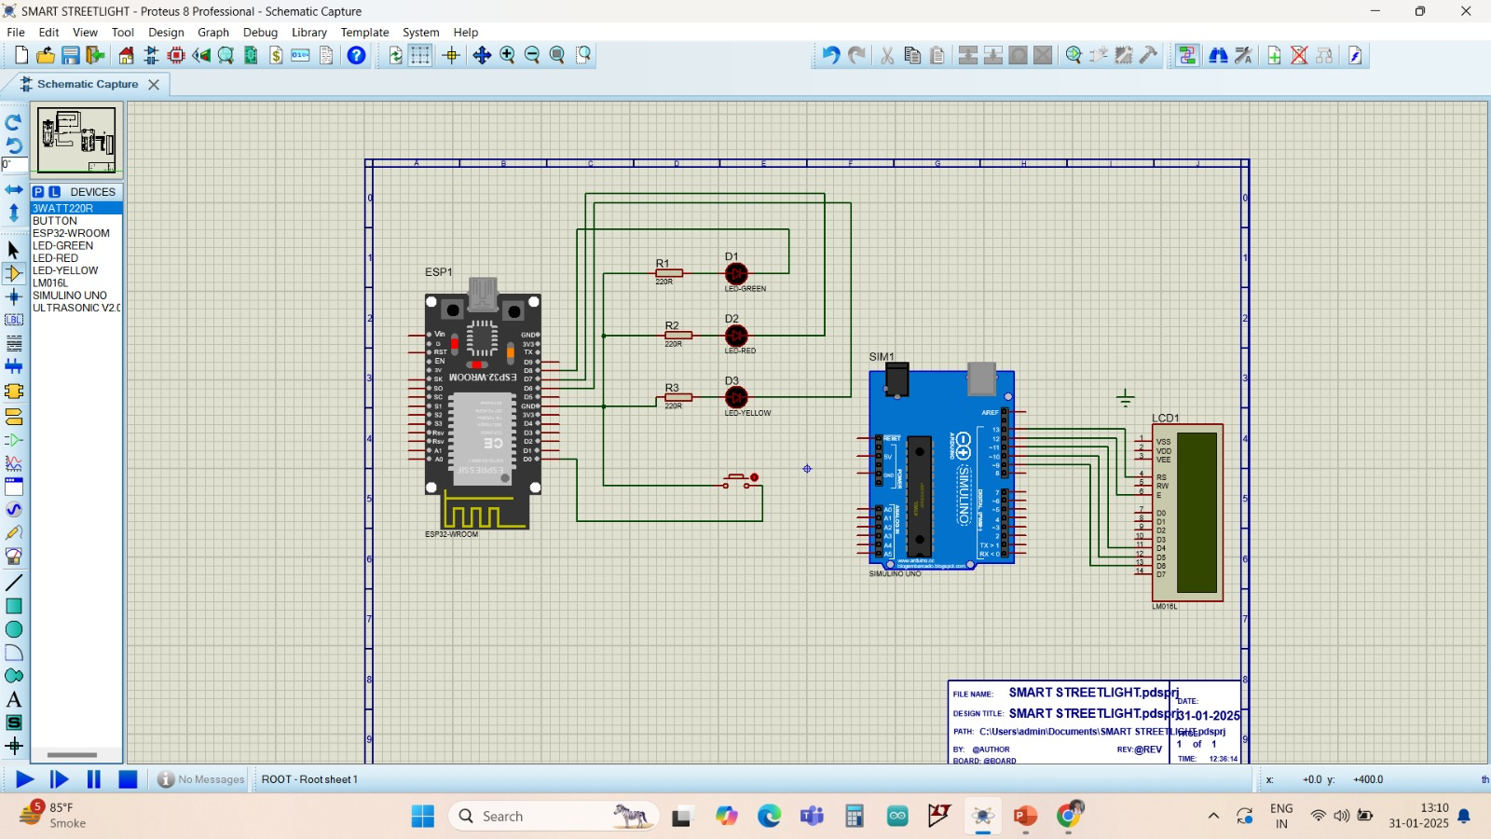
System Architecture
2.0
A 24-HOUR HARDWARE HACKATHON
Workflow Diagram/Circuit diagram
[Team Name]:

Slide 9
Problem Statement
2.0
A 24-HOUR HARDWARE HACKATHON
PROBLEM STATEMENT: THE SMART CITY SENTINEL-A MODULAR PCB FOR INTELLIGENT ENVIRONMENTAL MONITORINGDesign and develop a modular PCB using the open-source software KiCad within the next 4 hours to serve as the backbone of an advanced central monitoring system for urban environmental surveillance. This Smart City Environmental Sentinel must seamlessly integrate sensor interfacing, power management, and real-time data transmission within a scalable and efficient architecture while adhering to strict power and connectivity constraints. The PCB must feature correctly mapped communication protocols for all sensor modules and actuators, along with a robust power management unit that includes battery monitoring, recharging capabilities, and an integrated solar panel interface. The design should ensure scalability and modularity, allowing for future enhancements with minimal redesign, using only standard electronic components readily available in any electronics lab.Additional Points: Participants who incorporate a precision-engineered PCB layout with a 3D CAD model
[Team Name]:

Slide 10
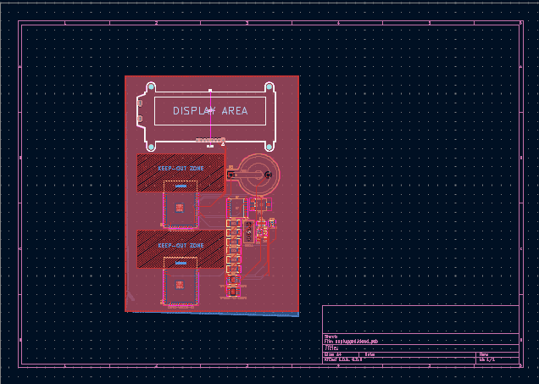
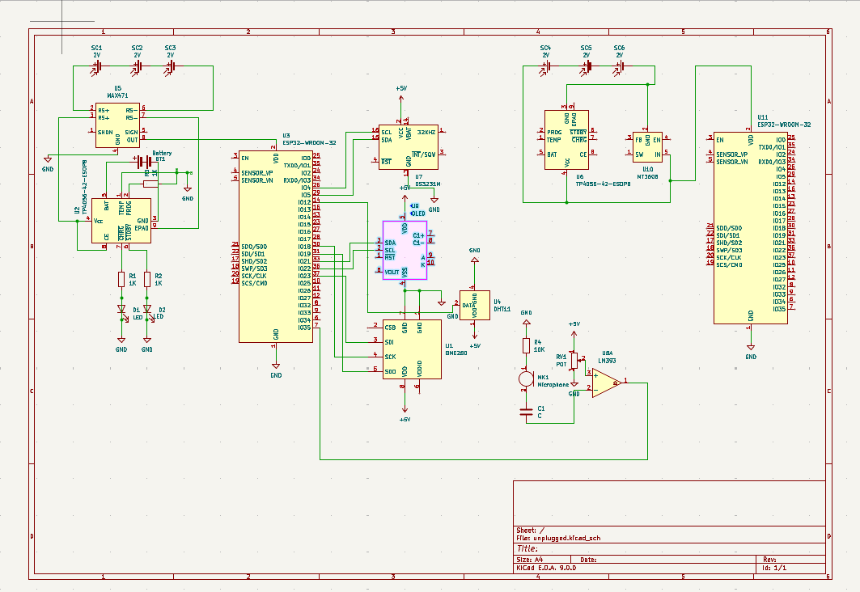
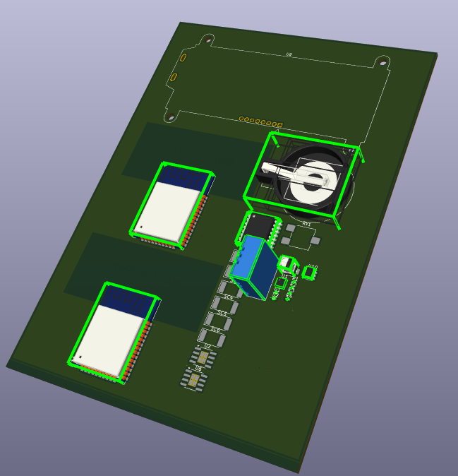

Slide 11
Budget Report
2.0
A 24-HOUR HARDWARE HACKATHON
[Cost breakdown with the list of components and softwares used in building the solution]
Arduino uno*2: 680
Esp32:550
Server motor*3:600
Led lights:200
push button:10
Ultrasonic sensor :200
Lcd display*2=700
[Team Name]:

Slide 12
Impact and Benefits
2.0
A 24-HOUR HARDWARE HACKATHON
[Potential impact]
[Benefits of the solution(social,economic,environmental,etc)]
Smart Traffic Lights
🚑 Faster Emergency Response: Automatically turns signals green for ambulances and fire trucks, ensuring quicker arrivals and saving lives.
🚦 Adaptive Traffic Flow: Adjusts signal timings based on real-time traffic data, reducing congestion and improving road efficiency.
🚘 Enhanced Road Safety: Alerts drivers to emergency vehicles, minimizing sudden lane changes and accident risks.
⏳ Fuel & Time Efficiency: Reduces idling, lowers fuel consumption, and cuts emissions for a more eco-friendly city.
📡 Scalable & Future-Ready: Supports police, disaster response, and public transport while integrating with existing infrastructure
Smart Dustbin
🗑️ Improved Hygiene: Automatic lid operation prevents direct contact, reducing the spread of germs and foul odors.
🚯 Reduced Littering: Sensors detect waste levels and alert authorities for timely disposal, preventing overflow and keeping public spaces clean.
🐛 Pest Control: Sealed design prevents flies, rodents, and pests, enhancing sanitation.
🌱 Eco-Friendly Waste Management: Promotes efficient waste segregation and disposal, reducing pollution and supporting sustainability.
📡 Smart Monitoring: Real-time waste level tracking optimizes collection schedules, reducing unnecessary trips and fuel consumption.
[Team Name]:

Slide 13
IMPORTANT INSTRUCTIONS
2.0
A 24-HOUR HARDWARE HACKATHON
- Kindly keep the maximum slide limit up to 10 (excluding this slide, you may delete this slide before submitting on the portal.)
- ⁠Try to avoid paragraphs and post your ideas in points/diagrams/pictures
- ⁠Keep your explanation precise and easy to understand, avoid using jargons
- ⁠Idea should be unique
- ⁠You can only use provided template for making PPT, without changing the idea details,pointers (mentioned on each slide)
- ⁠You need to upload the file in PPT format only. No PDF,Word Doc or any other format will be accepted.

